Slide 1
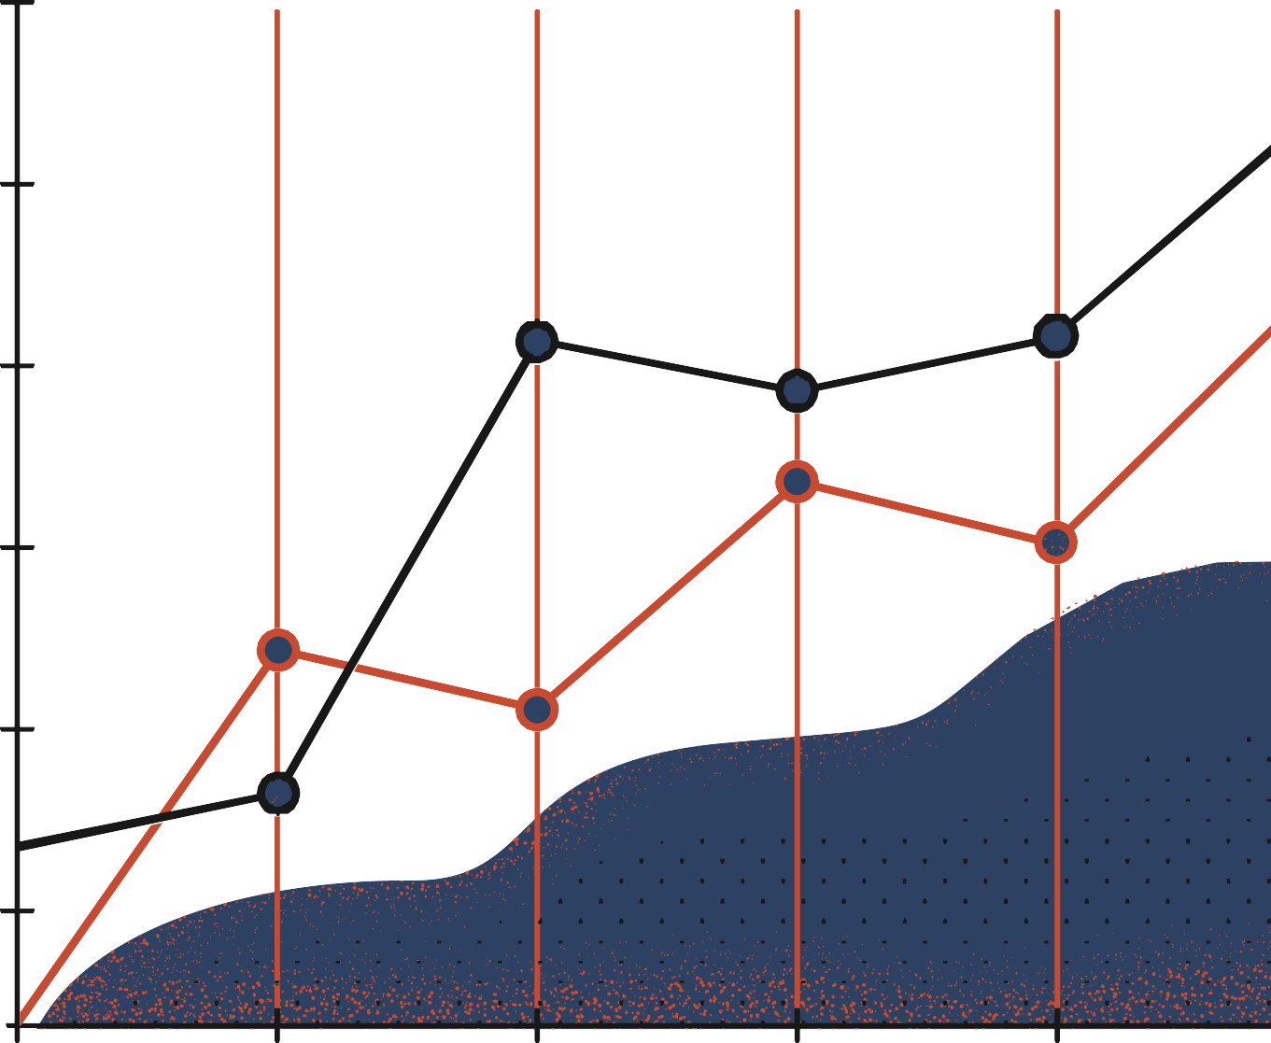


Multilayer Perceptron
Pavlos Protopapas

Slide 2

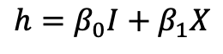

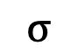
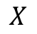
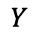
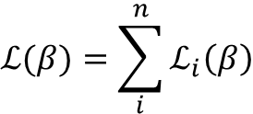
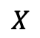
A single neuron
Up to this point we just re-branded logistic regression or linear regression to look like a neuron.
Activation sigmoid identify
Loss
Function
$$ℒ(β)=\sum_{i}^{n}{ℒ_{i}\left(β\right)}$$
$$X$$
Affine
$$h=β_{0}I+β_{1}X$$
$$y=σ(h)$$
$$W$$
$$σ$$
$$Y$$
$$X$$

Slide 3
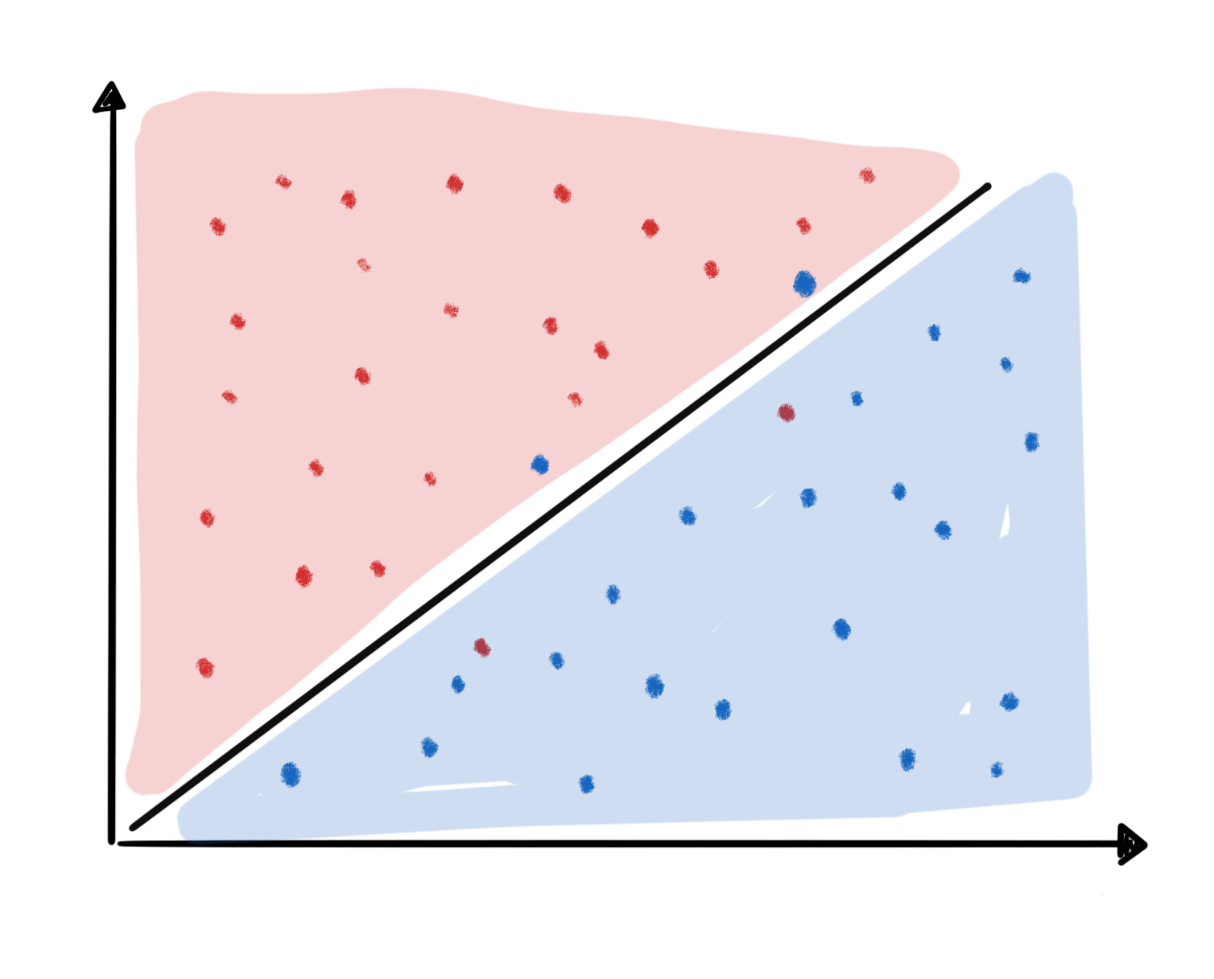
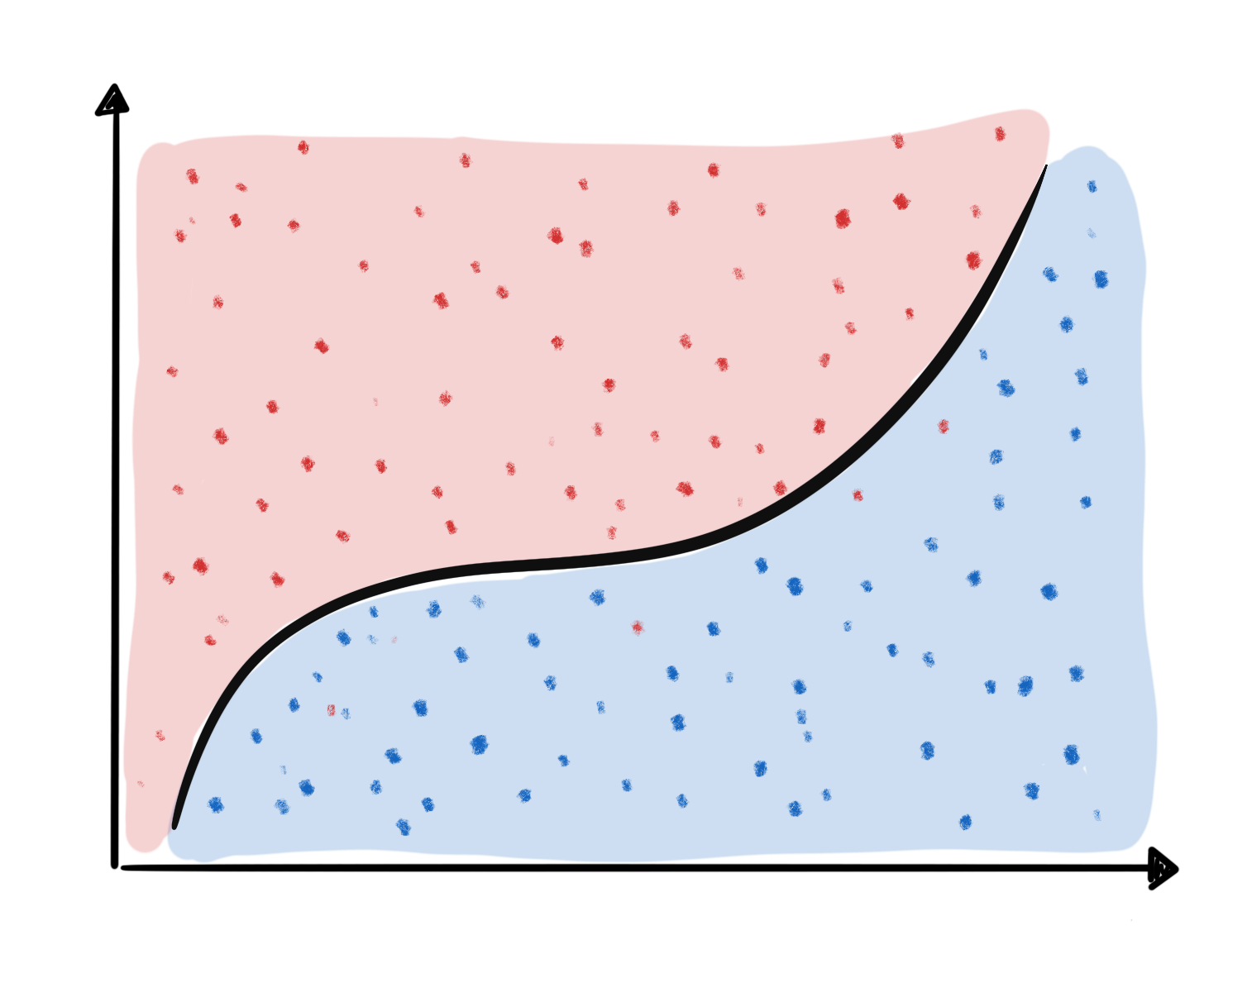
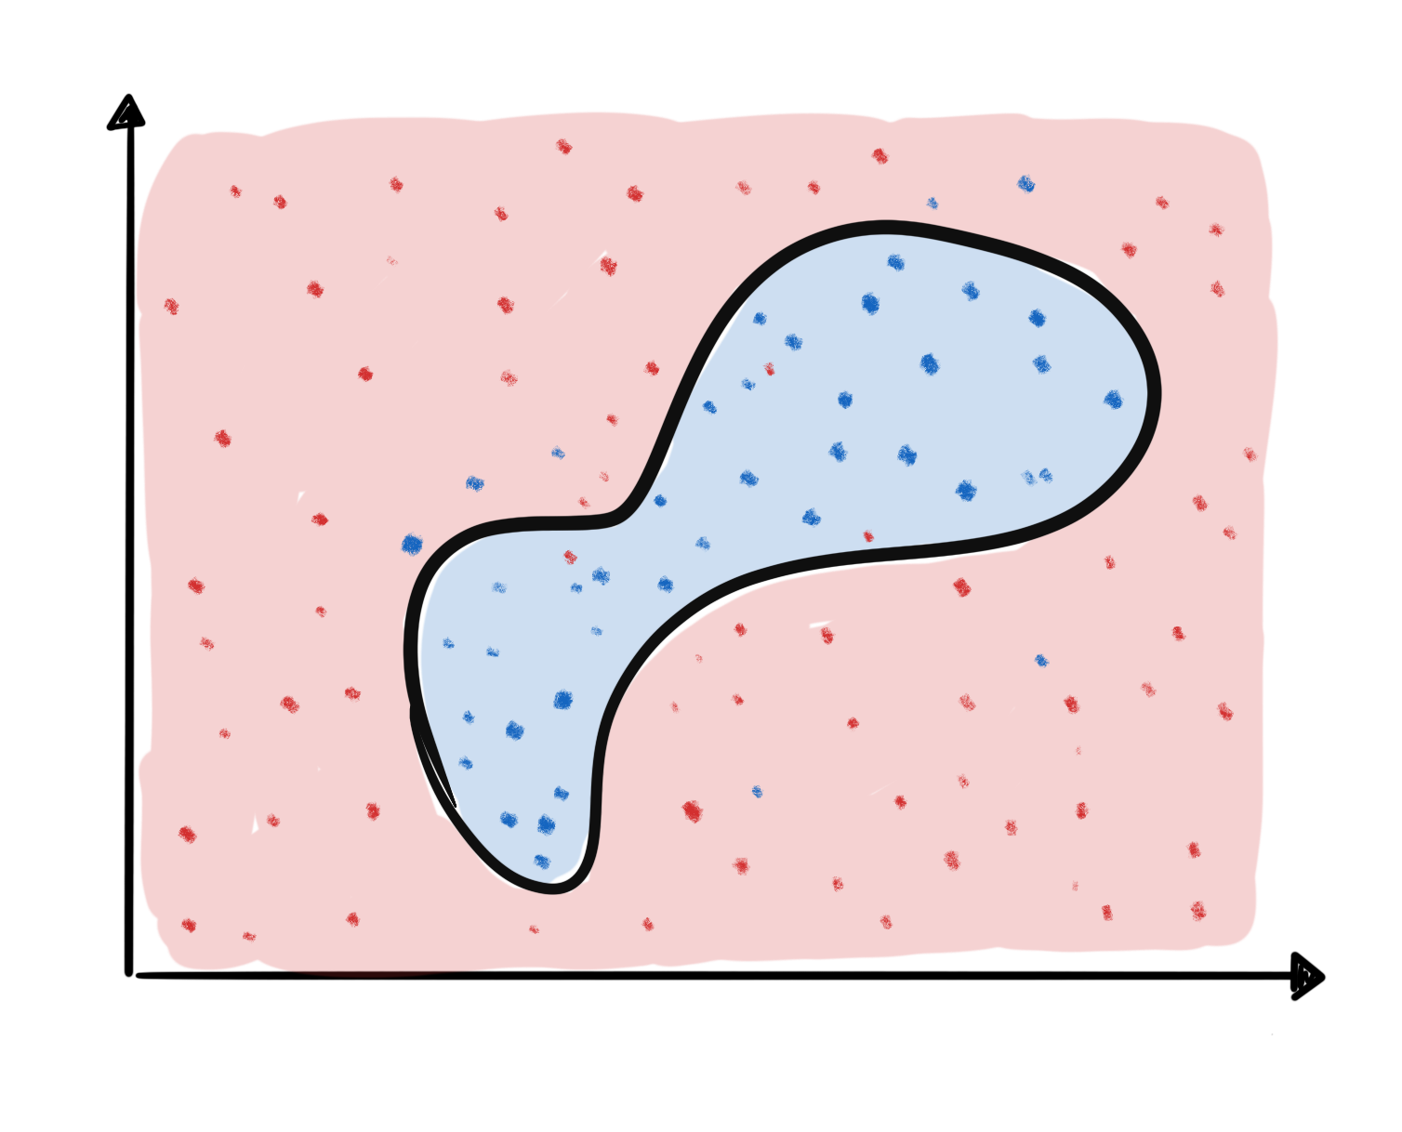
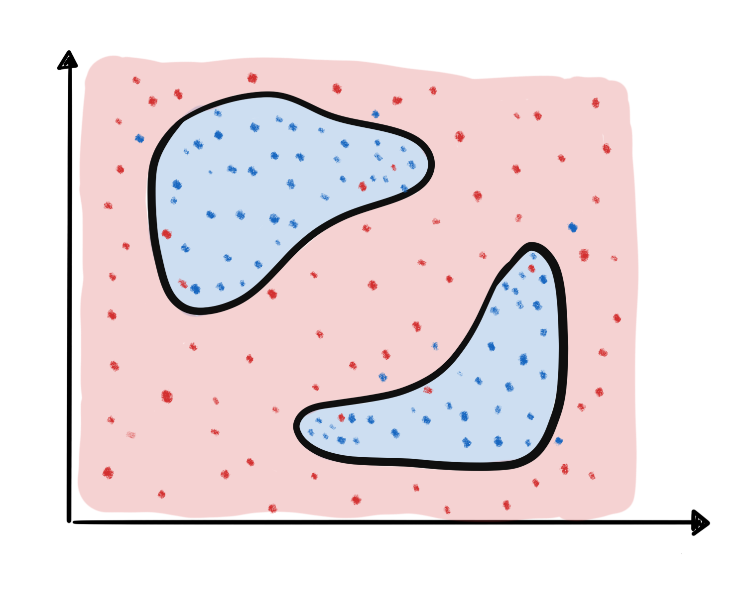
So, what’s the big deal about Neural Networks?
X₂
X₂
X₁
X₁
X₂
X₂
Very hard to express boundaries like these with logistic regression
X₁
X₁

Slide 4
So, what’s the big deal about Neural Networks?
X₂
X₂
No Linear Boundaries!
X₁
X₁
X₂
X₂
X₁
X₁

Slide 5
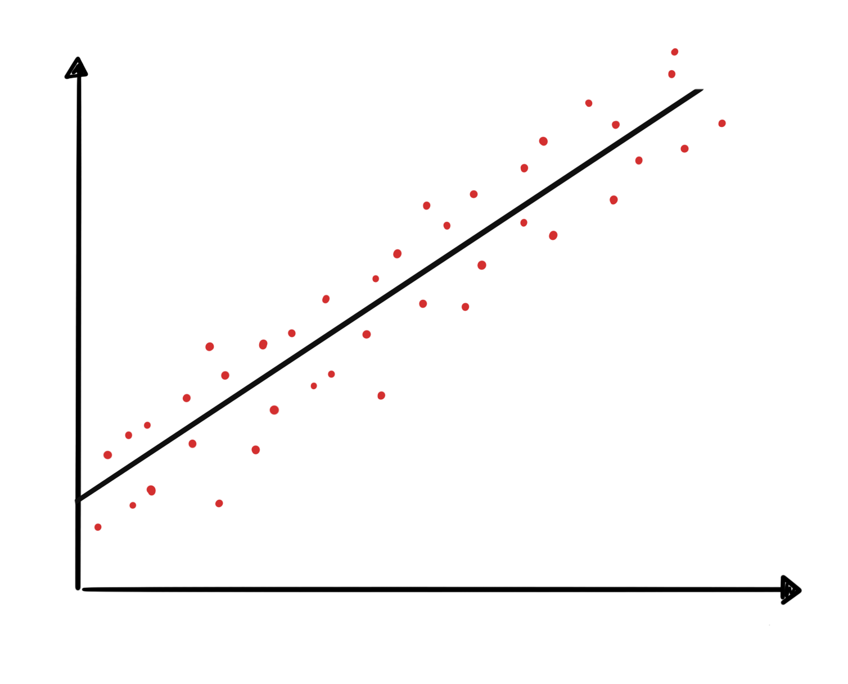
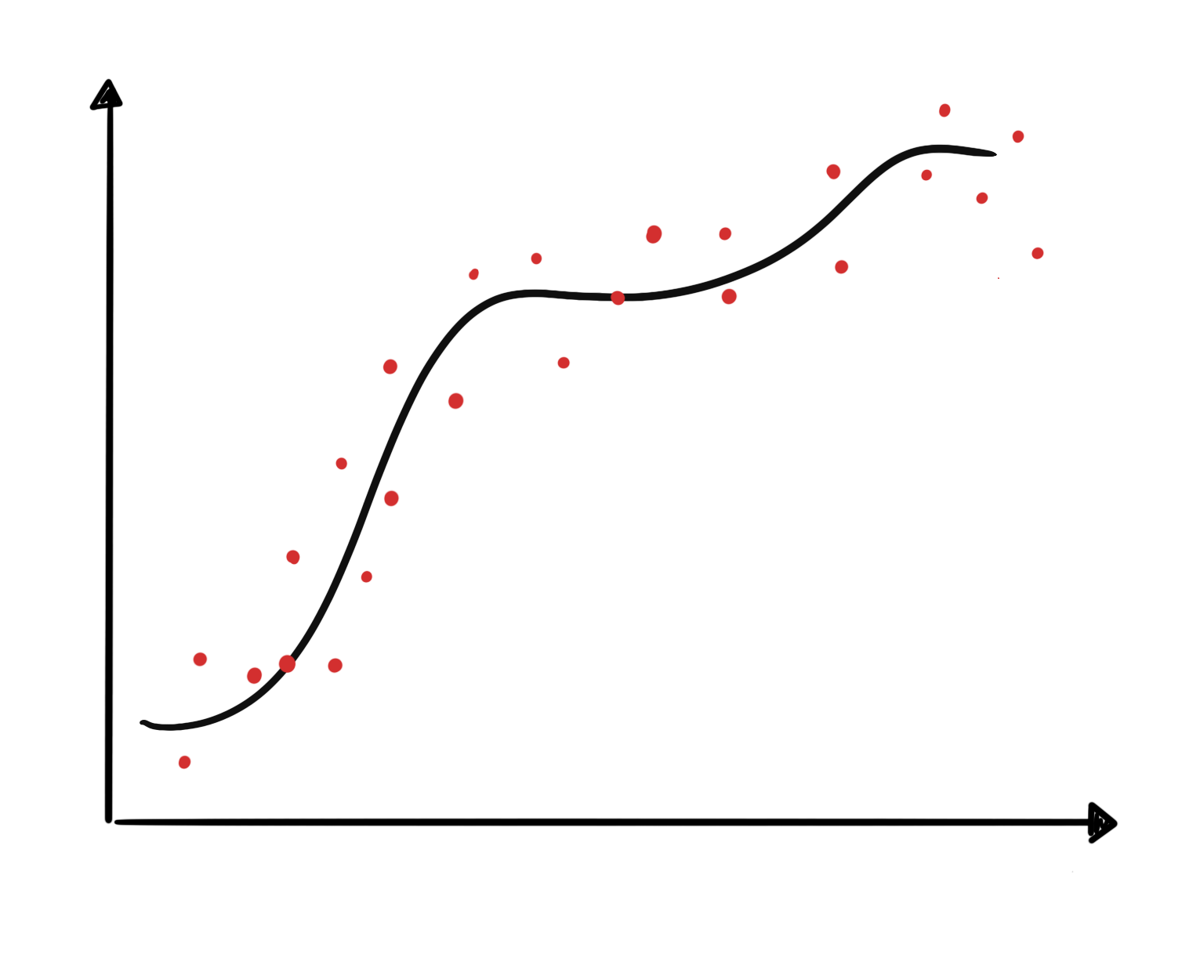
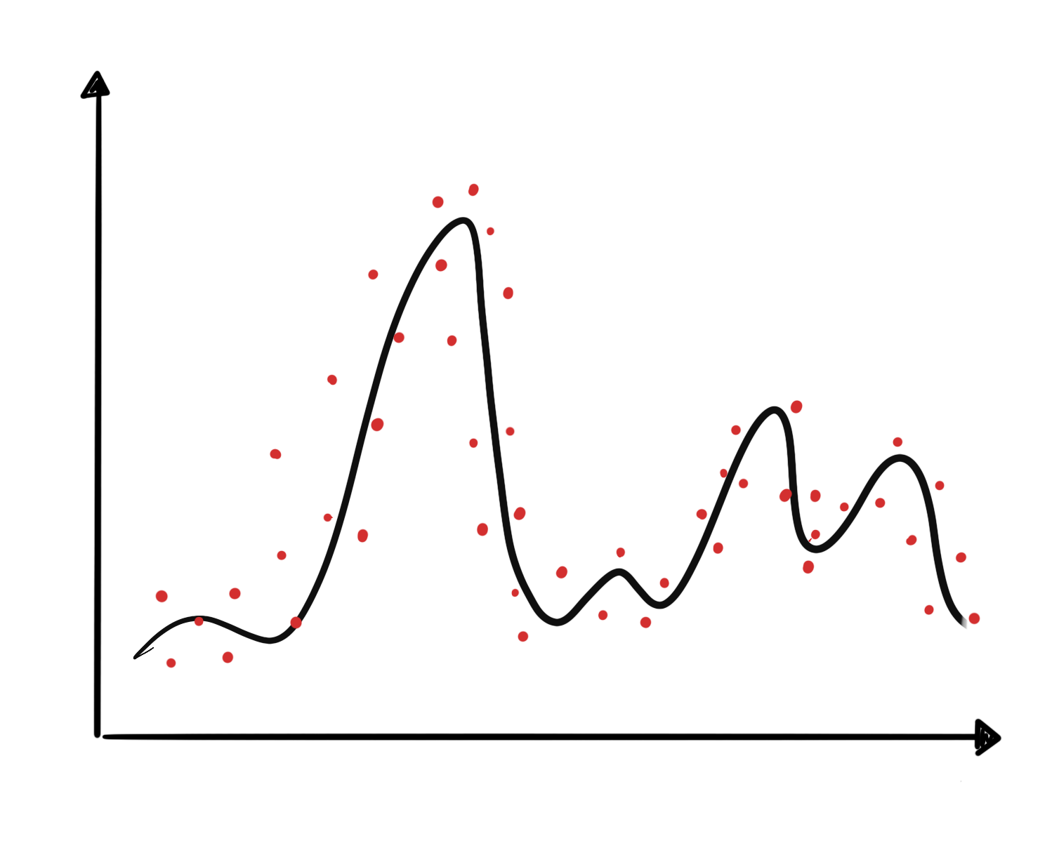
So, what’s the big deal about Neural Networks?
Y
Y
X
X
Y
Very hard to express functions like these with polynomial regression.
X

Slide 6
So, what’s the big deal about Neural Networks?
Y
Y
No Linear Functions!
X
X
Y
X

Slide 7

So, what’s the big deal about Neural Networks?
How can we overcome these challenges?
Neural Network

Slide 8
Outline
Introduction to Artificial Neural Networks
Review of Classification and Logistic Regression
Single Neuron Network (‘Perceptron’)
Multi-Layer Perceptron (MLP)

Slide 9
Example Using Heart Data
Consider a dataset that contains a binary outcome AHD for 303 patients who presented with chest pain.
Age | Sex | ChestPain | RestBP | Chol | MaxHR | ExAng | Thal | AHD
63 | 1 | typical | 145 | 233 | 150 | 0 | fixed | No
67 | 1 | asymptomatic | 160 | 286 | 108 | 1 | normal | Yes
67 | 1 | asymptomatic | 120 | 229 | 129 | 1 | reversable | Yes
37 | 1 | nonanginal | 130 | 250 | 187 | 0 | normal | No

Slide 10
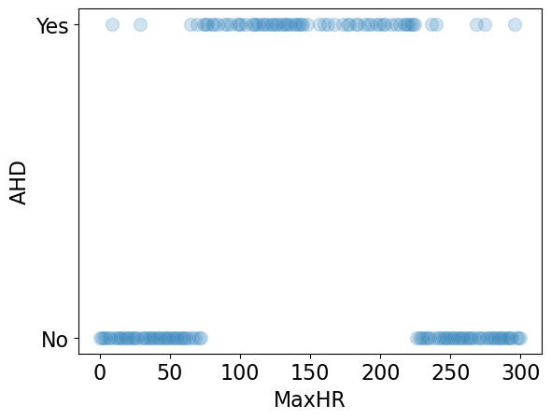
Example Using Heart Data
Slightly modified data to illustrate concepts.

Slide 11
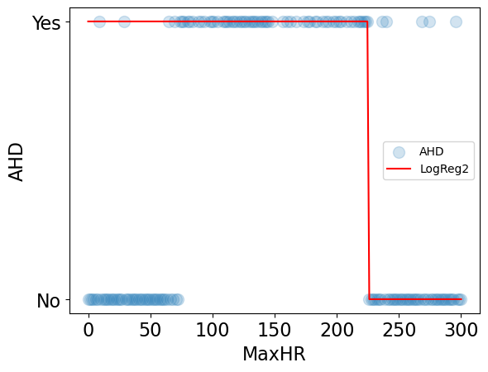
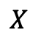

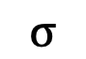
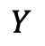
Example Using Heart Data
Choose W such as right part of data is fitted well.
$$W$$
$$σ$$
$$Y$$
$$X$$

Slide 12
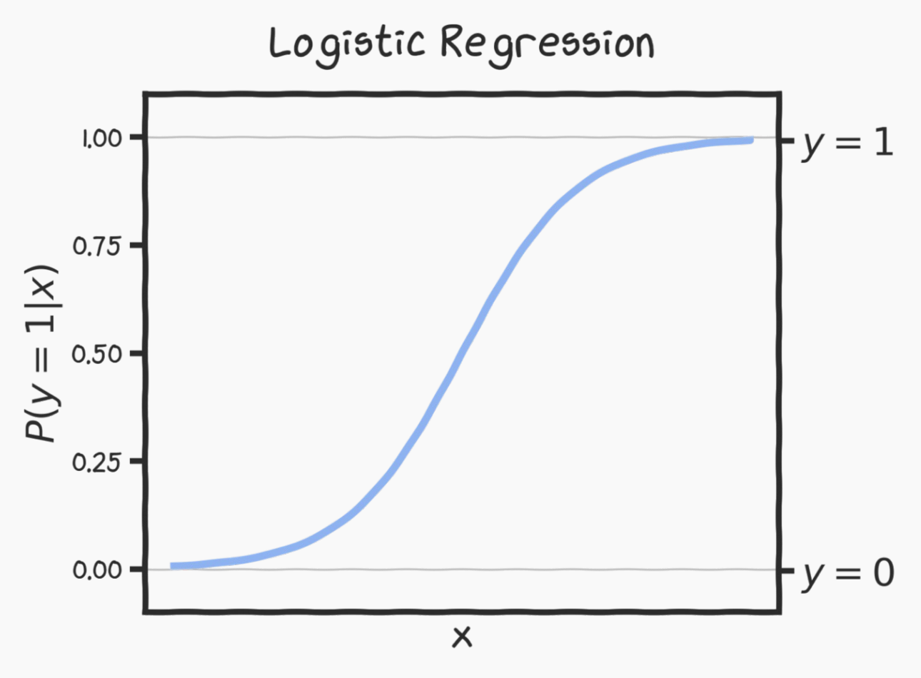
Quiz Time
What would be the expected behavior of the logistic regression function below if we increase the bias (b or W₀)?
The curve will shift upwards
The curve will shift downwards
The curve will shift to the left
The curve's slope will become steeper

Slide 13
Quiz Time
What would be the expected behavior of the logistic regression function below if we increase the bias (b or W₀)?
The curve will shift upwards
The curve will shift downwards
The curve will shift to the left
The curve's slope will become steeper

Slide 14
Example Using Heart Data
Choose W such as right part of data is fitted well
$$W$$
$$σ$$
$$Y$$
$$X$$

Slide 15
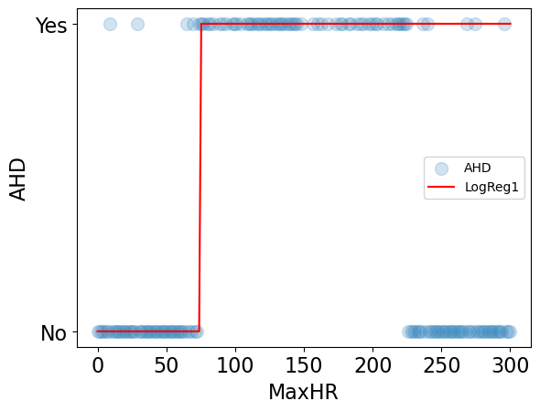
Example Using Heart Data
Choose W such as left part of data is fitted well
$$W$$
$$σ$$
$$Y$$
$$X$$

Slide 16
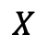
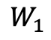
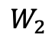
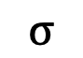
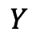
Example Using Heart Data
Two regions, two nodes
$$W_{1}$$
$$σ$$
$$Y$$
$$X$$
$$W_{2}$$
$$σ$$
$$Y$$
$$X$$

Slide 17
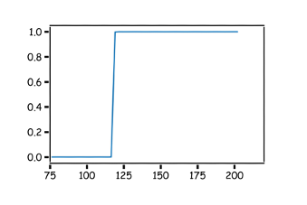
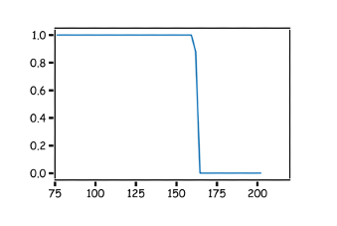



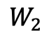
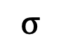
Combining Neurons
$$W_{1}$$
$$z_{1}$$
$$σ$$
$$X$$
$$W_{2}$$
$$z_{2}$$
$$σ$$

Slide 18
Quiz Time
How shall we combine these results?
Multiply z₁ and z₂
Add z₁ and z₂
σ(z₁) + σ(z₂)
Convolve z₁ with z₂

Slide 19
Quiz Time
How shall we combine these results?
Multiply z₁ and z₂
Add z₁ and z₂
σ(z₁) + σ(z₂)
Convolve z₁ with z₂

Slide 20
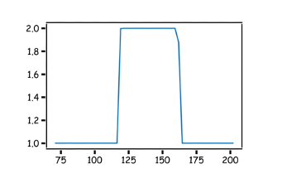
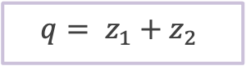
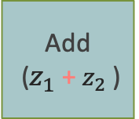
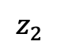
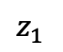
Combining Neurons
$$W_{1}$$
$$z_{1}$$
$$z_{1}$$
$$q= z_{1}+z_{2}$$
$$σ$$
Add
($z_{1}$ + $z_{2}$ )
$$X$$
$$W_{2}$$
$$z_{2}$$
$$z_{2}$$
$$σ$$

Slide 21
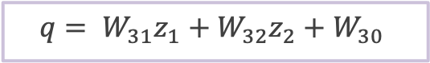
Combining Neurons
$$q= W_{31}z_{1}+{W_{32}z}_{2}+W_{30}$$
$$W_{1}$$
$$z_{1}$$
$$z_{1}$$
$$σ$$
Affine
$$X$$
$$W_{2}$$
$$z_{2}$$
$$z_{2}$$
$$σ$$

Slide 22
Combining Neurons
$$q= W_{31}z_{1}+{W_{32}z}_{2}+W_{30}$$
$$W_{1}$$
$$z_{1}$$
$$z_{1}$$
$$σ$$
Affine
$$X$$
$$W_{2}$$
$$z_{2}$$
$$z_{2}$$
$$σ$$
But this is not a probability.

Slide 23
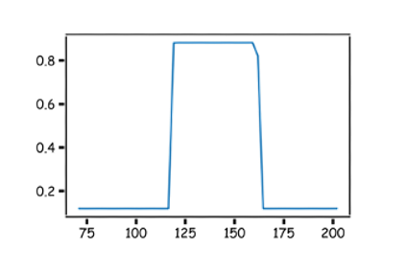
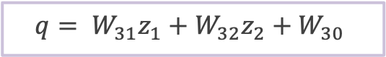

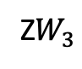
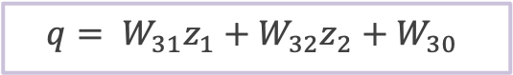
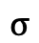
Combining Neurons
$$q= W_{31}z_{1}+{W_{32}z}_{2}+W_{30}$$
$$p=\frac{1}{1+e^{−q}}$$
$$W_{1}$$
$$z_{1}$$
$$z_{1}$$
$$σ$$
$$X$$
Z$W_{3}$
$$σ$$
$$W_{2}$$
$$z_{2}$$
$$z_{2}$$
$$σ$$
Passing through sigmoid yields probabilities.

Slide 24
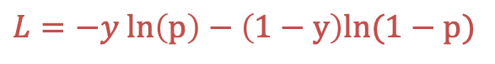

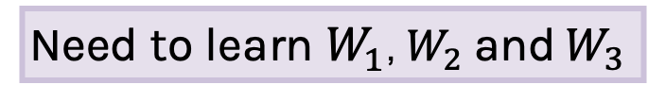
Combining Neurons
$$q= W_{31}z_{1}+{W_{32}z}_{2}+W_{30}$$
$$p=\frac{1}{1+e^{−q}}$$
$$W_{1}$$
$$z_{1}$$
$$z_{1}$$
$$σ$$
$$X$$
Z$W_{3}$
$$σ$$
$$W_{2}$$
$$z_{2}$$
$$z_{2}$$
$$σ$$
Passing through sigmoid yields probabilities
We will talk about about this in the coming lectures
$$L=−y ln\left(p\right)−\left(1−y\right)ln(1−p)$$
Need to learn $W_{1}$, $W_{2}$ and $W_{3}$

Slide 25
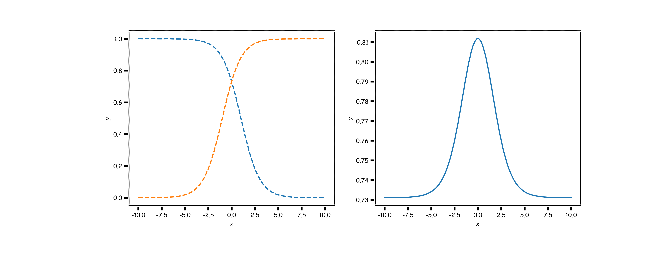
Combining neurons allows us to model interesting functions
X
Y

Slide 26
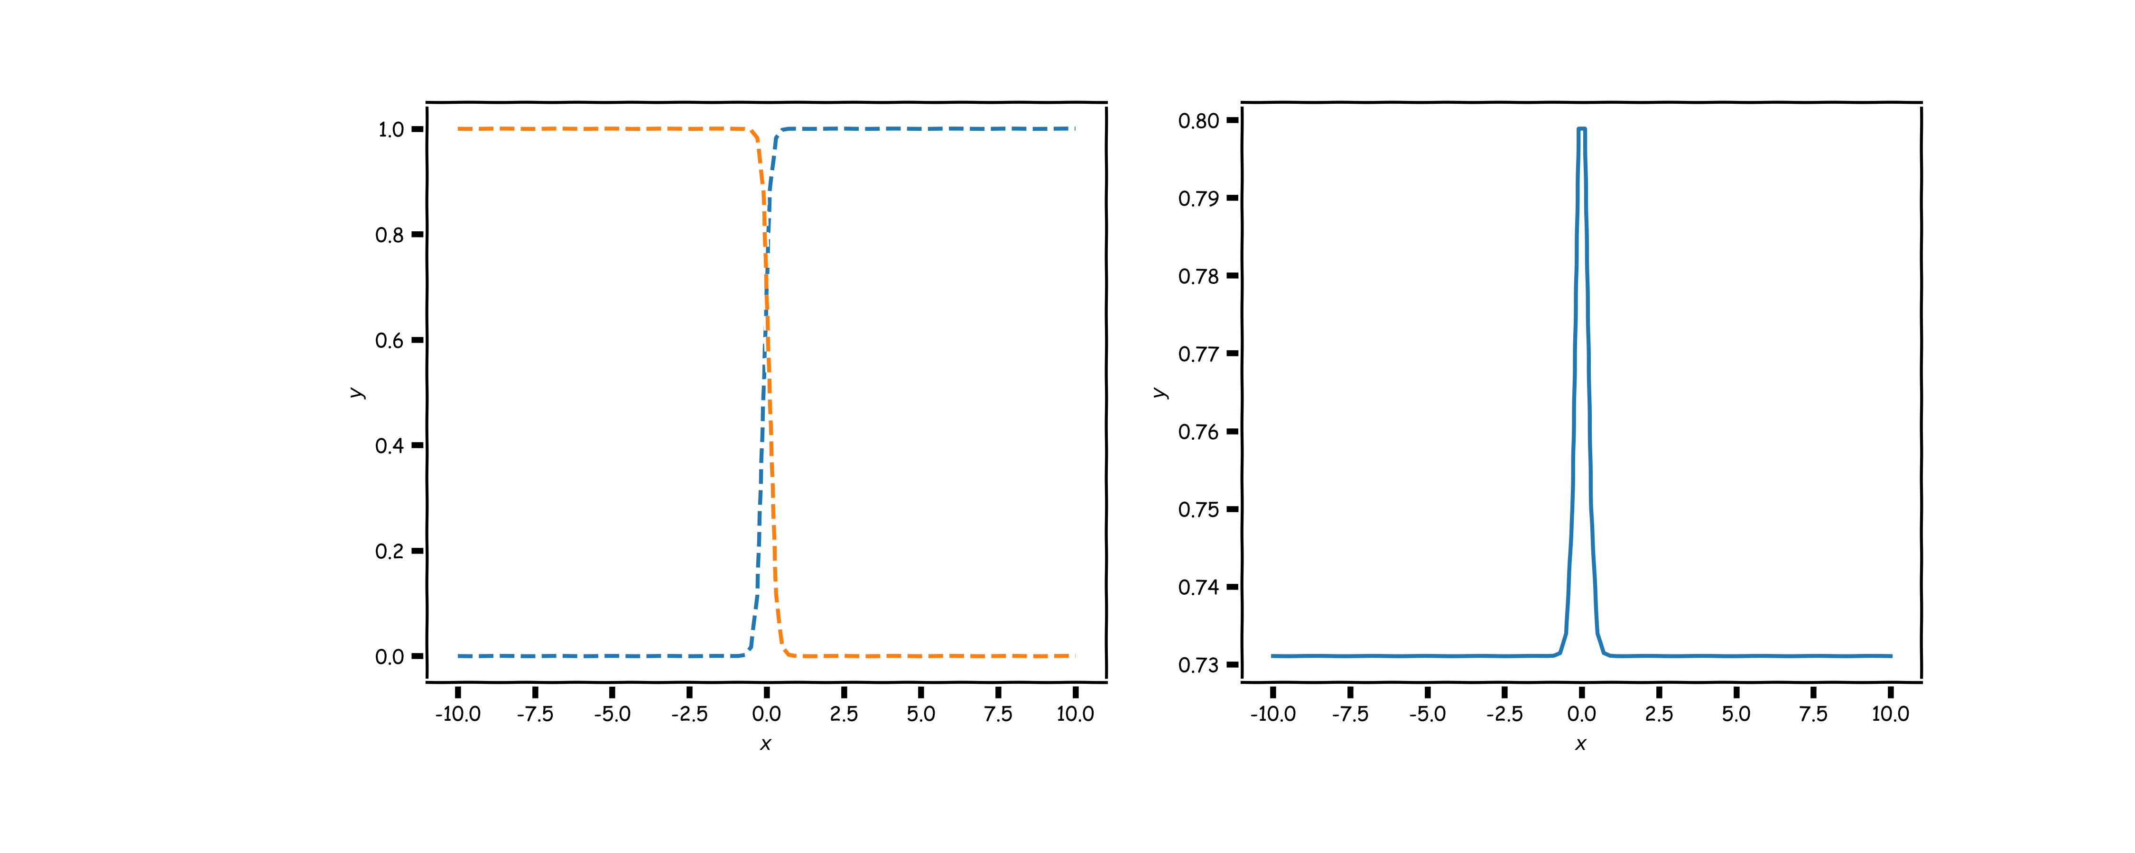
Different weights change the shape and position
X
Y

Slide 27
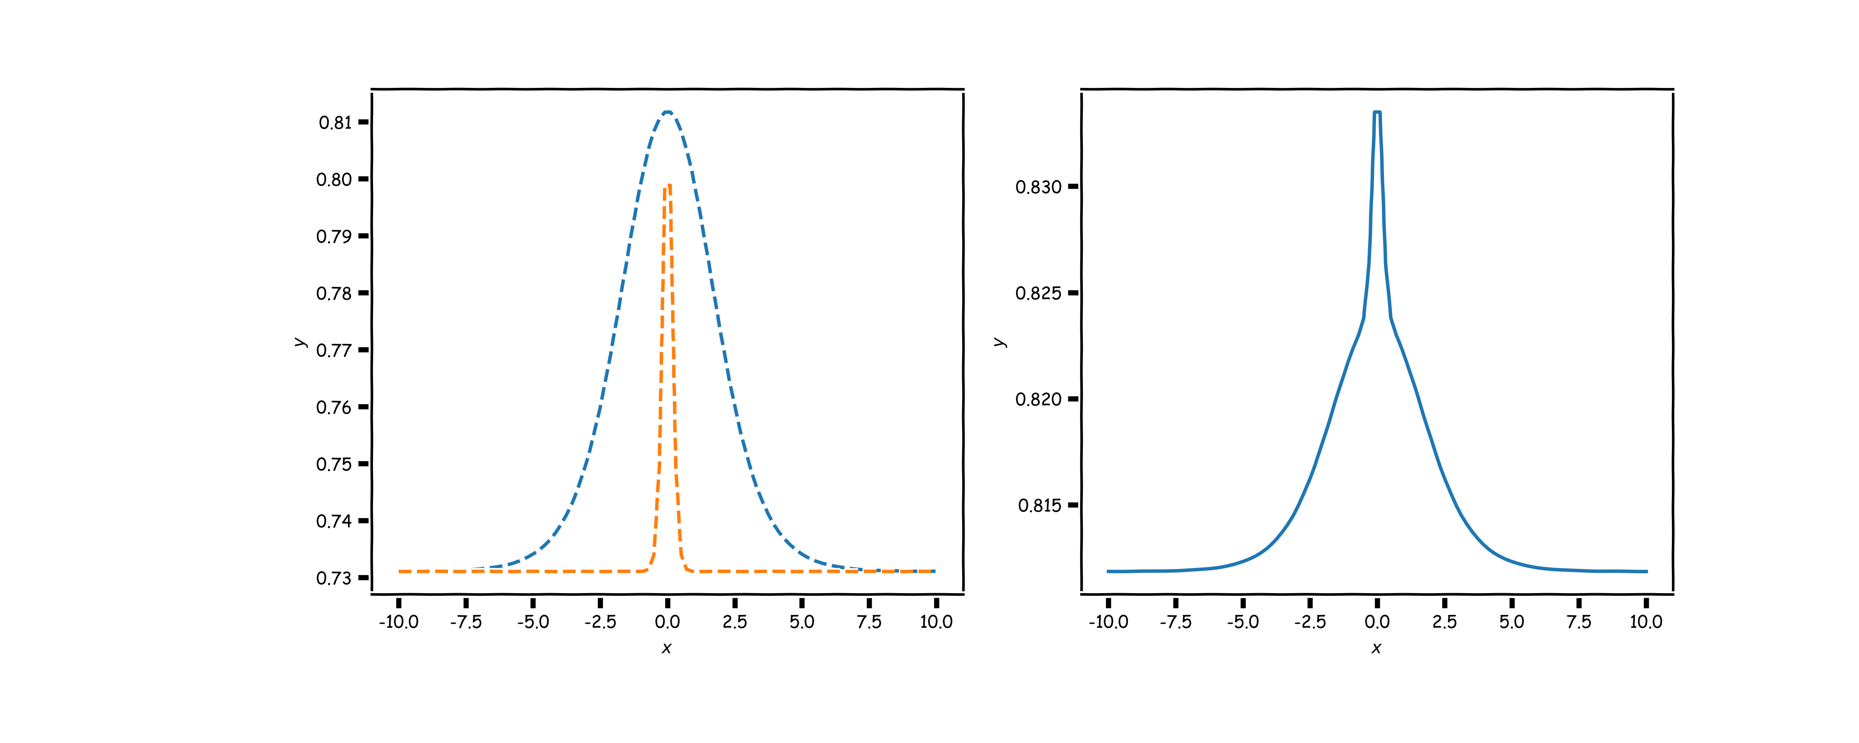
Neural networks can model any reasonable function
X
Y

Slide 28
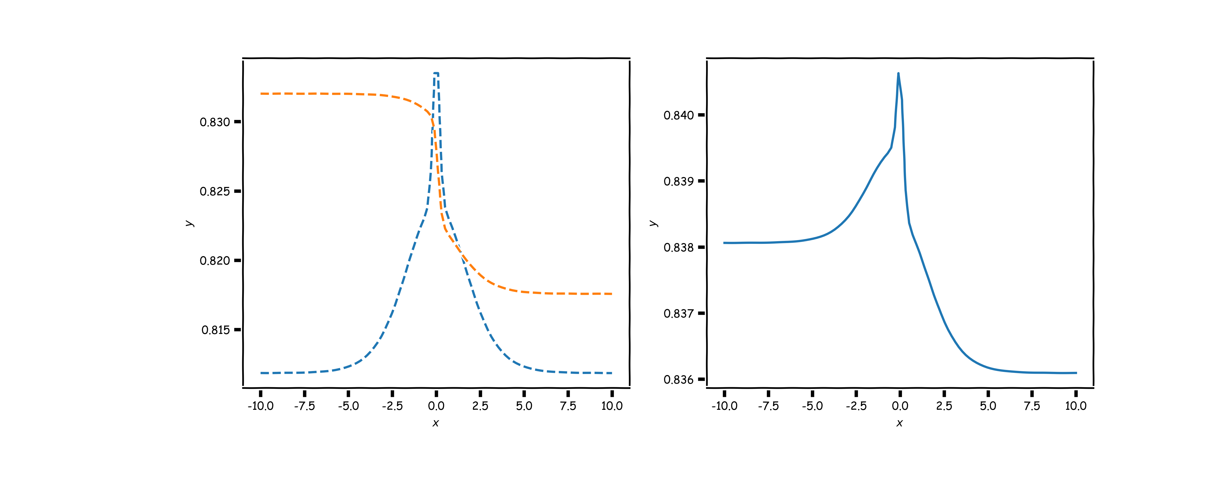
Neural networks can model any reasonable function
X
Y

Slide 29
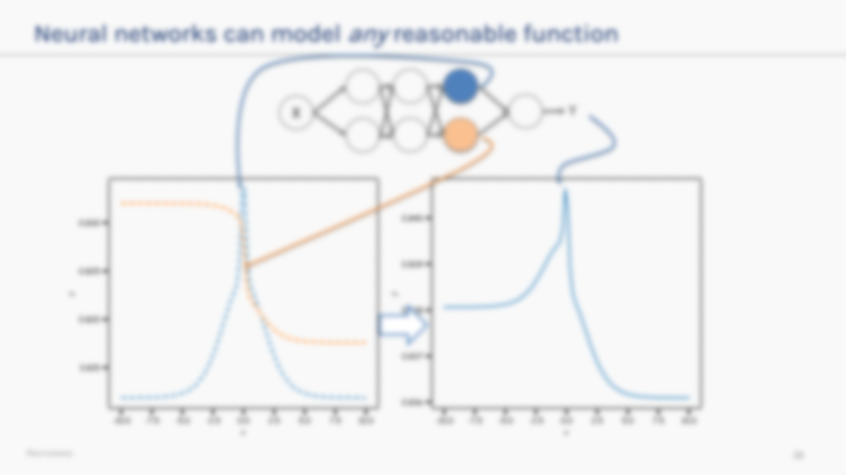

Neural networks can model any reasonable function
So, adding neurons and layers allows us to model increasingly complex functions and that is what a Neural Network is.
X
Y

Slide 30
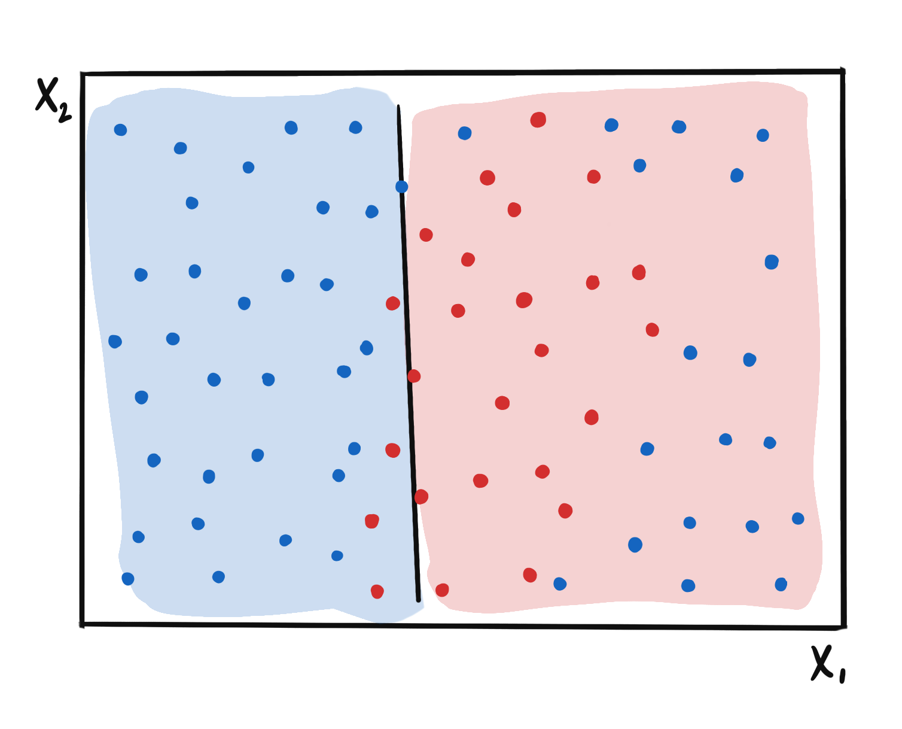
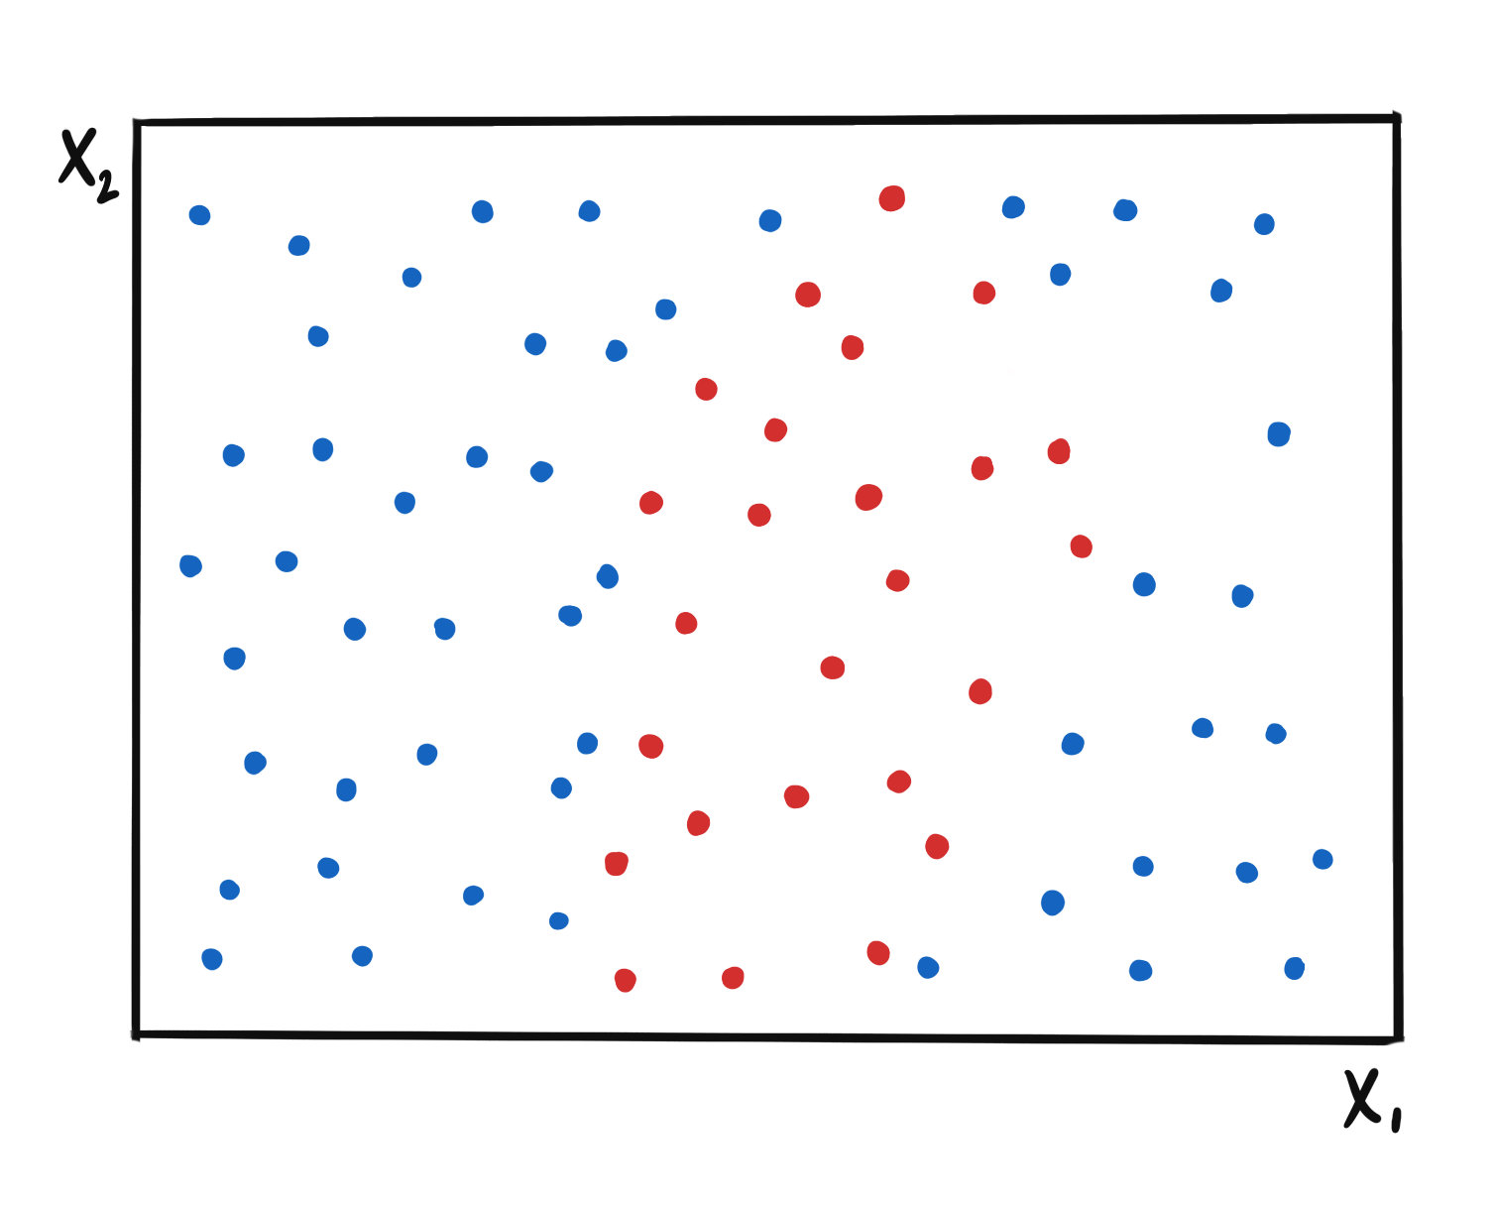









For 2-D input the same idea applies
$$XW_{1}$$
$$σ$$
$$XW_{3}$$
$$σ$$
$$XW_{2}$$
$$σ$$

Slide 31
Summary
So far:
A single neuron can be a logistic regression or linear unit. We will soon see other choices of activation functions.
A neural network is a combination of logistic regression (or other types) units.
A neural network can approximate non-linear functions either for regression or classification.

Slide 32

Summary
Next:
What kind of activations?
How many neurons?
How many layers?
How to construct the output unit?
What loss functions are appropriate?
Don’t worry it’s not as difficult as it sounds

Slide 33
Summary
Following two lectures on NN:
How do we estimate the weights and biases?
How to regularize Neural Networks?

Slide 34


Slide 35


